Slide 1

UNIT 1 TO 3 Getting started with node.Js upto Creating middlewares
BY:
AMANDEEP KAUR

Slide 2
Unit 1-3 Topics
Unit 1:
Getting Started with Node.JS
Handling Data I/O in Node.js
Unit 2:
Implementing HTTP Services in Node.JS
Basic Websites With Node.JS
Unit 3:
Socket Services in Node.js
Creating middlewares

Slide 3
TOPICS
Getting Started with Node.JS : Introducing Node.JS, Installing Node.js, Using Node.js Read Evaluate Print Loop(REPL), Node Pacakage Manager (npm), Initialize Node js project using npm init, NPM modules (Core Modules, Local Modules, Third Party Modules), EventEmitter in Node.js, Callbacks in Node.js
Handling Data I/O in Node.js : Working with fs module, Working with JSON, Using Stream Module to Stream Data, Compressing and Decompressing Data with Zlib, Promises and async/await

Slide 4
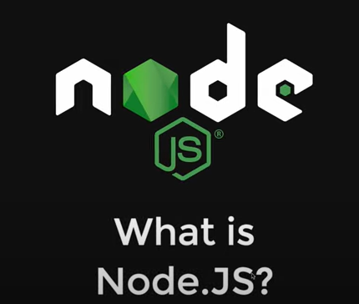
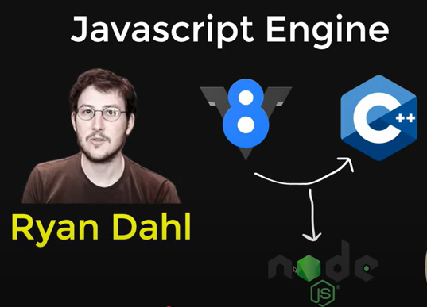
IT PROVIDE RUNTIME ENVIRONMENT

Slide 5
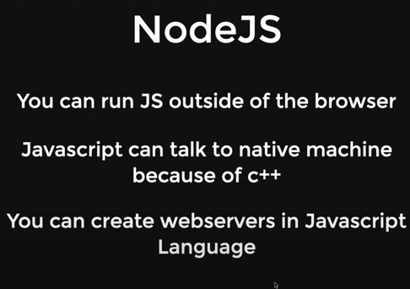
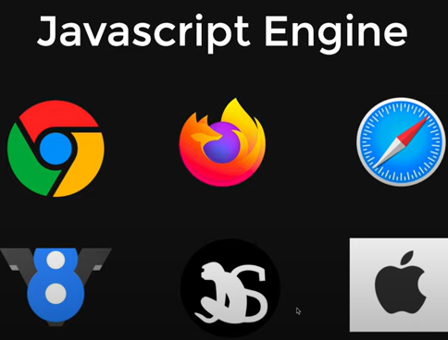

Slide 6
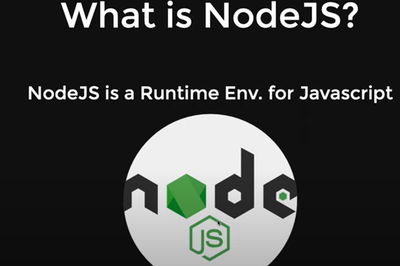

Slide 7
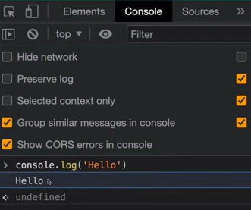

Slide 8
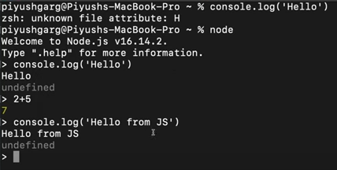

Slide 9
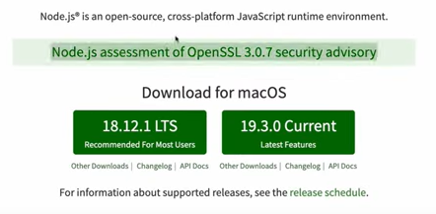
V24.10.0
V25.0.0
INSTALL “NODE JS & VS CODE”

Slide 10
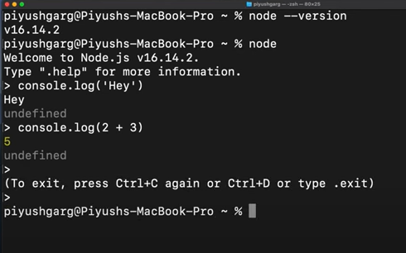
NODE
Ctrl + C or Ctrl + D

Slide 11
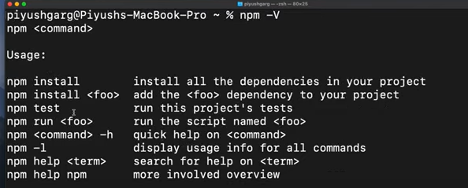
Node Package Manager (NPM)

Slide 12
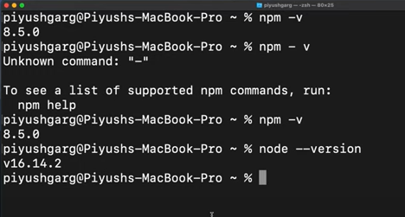
NPM

Slide 13
Create program to print “Hello into the world of NodeJS”
First create new folder “NODEJS”
OPEN VS CODE AND CREATE NEW NODE JS PROGRAM
SAVE THIS FILE WITH EXTENSION (.js), Moreover, its optional for to save the file with extension bcaz its run in both cases when we write “node”.

Slide 14
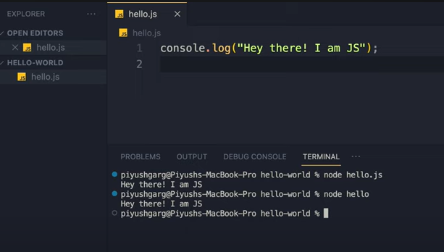

Slide 15
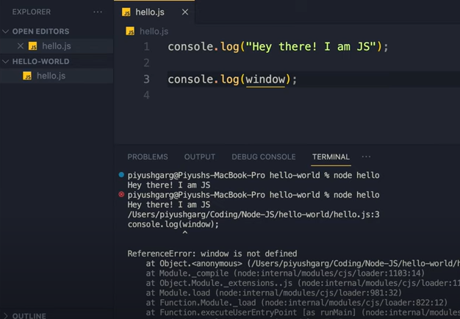

Slide 16
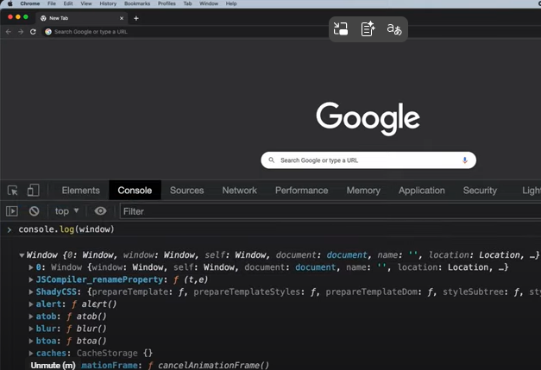

Slide 17
INTRODUCTION TO NODE.JS
Node.js is a JavaScript runtime environment that allows you to run JavaScript code outside the browser, typically on a server. It is built on Chrome's V8 JavaScript engine.
Key Features:
Asynchronous & Event-driven: Handles multiple operations without blocking the main thread.
Non-blocking I/O: Efficient for I/O-heavy tasks like reading files or databases.
Single-threaded: Uses a single-threaded model with event looping.
Cross-platform: Runs on Windows, macOS, and Linux.
npm (Node Package Manager): Huge ecosystem of open-source libraries.

Slide 18
INTRO TO NODE.JS
Common Uses:
Web servers and APIs
Real-time applications (e.g., chat apps)
Command-line tools
Microservices

Slide 19
INSTALLATION OF NODE JS (VERSION 24)
Node.js
LATEST VERSION: 24

Slide 20
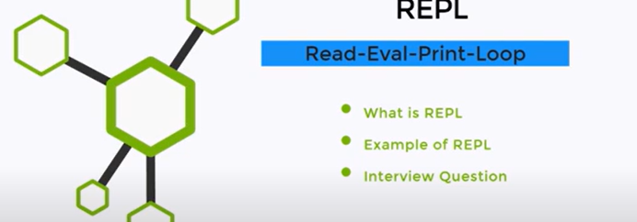

Slide 21
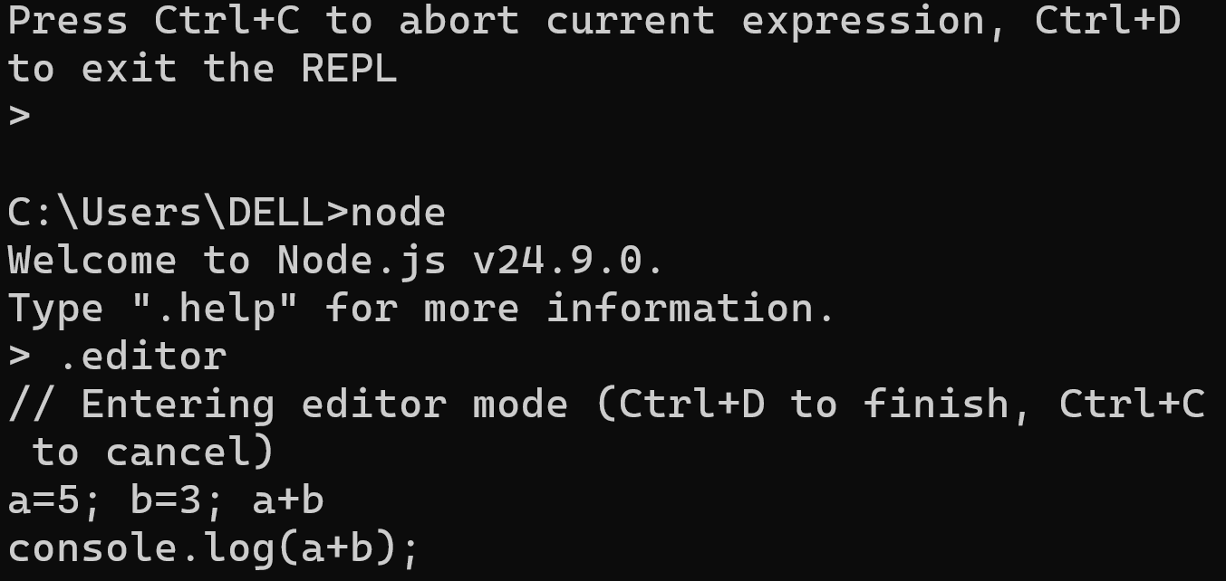

Slide 22
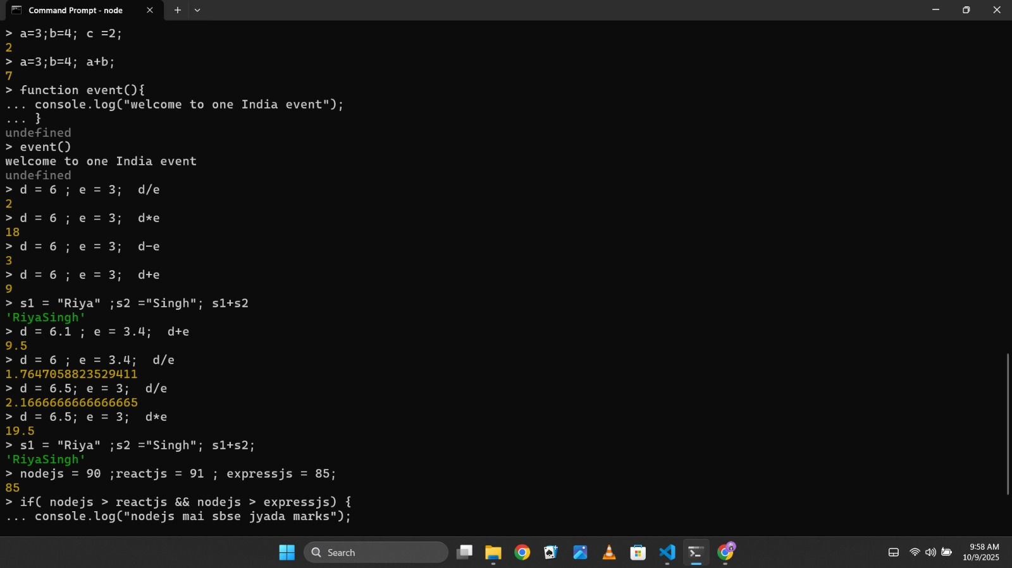

Slide 23
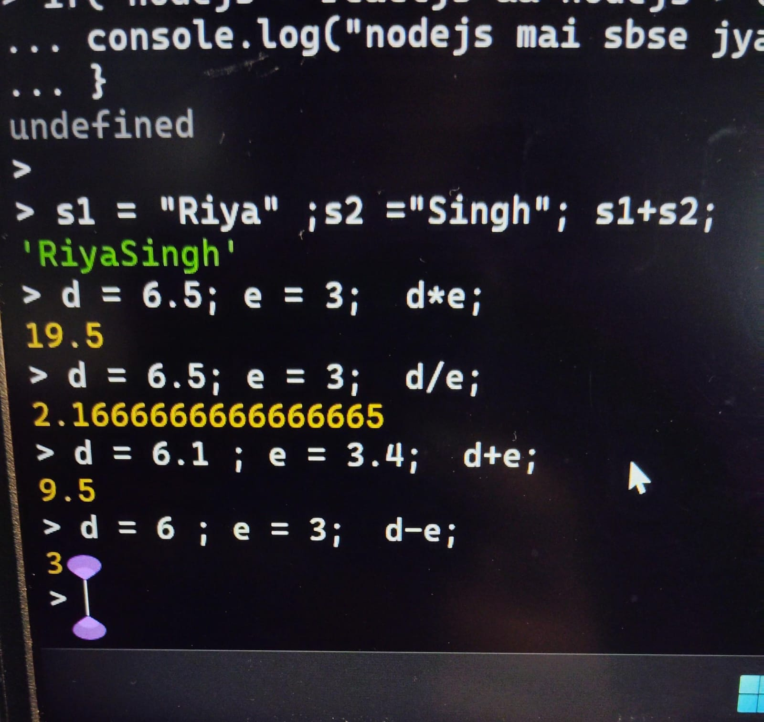

Slide 24
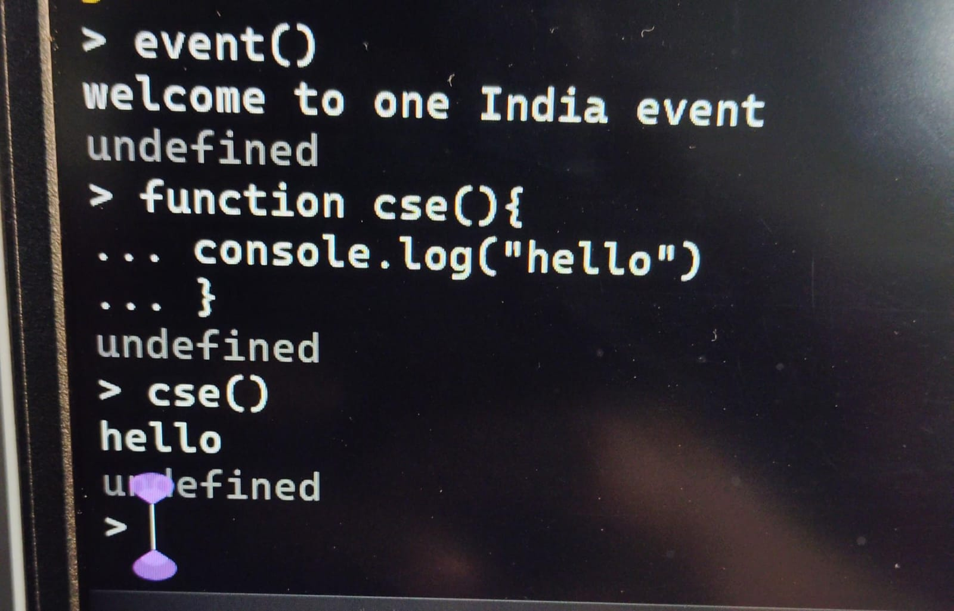

Slide 25
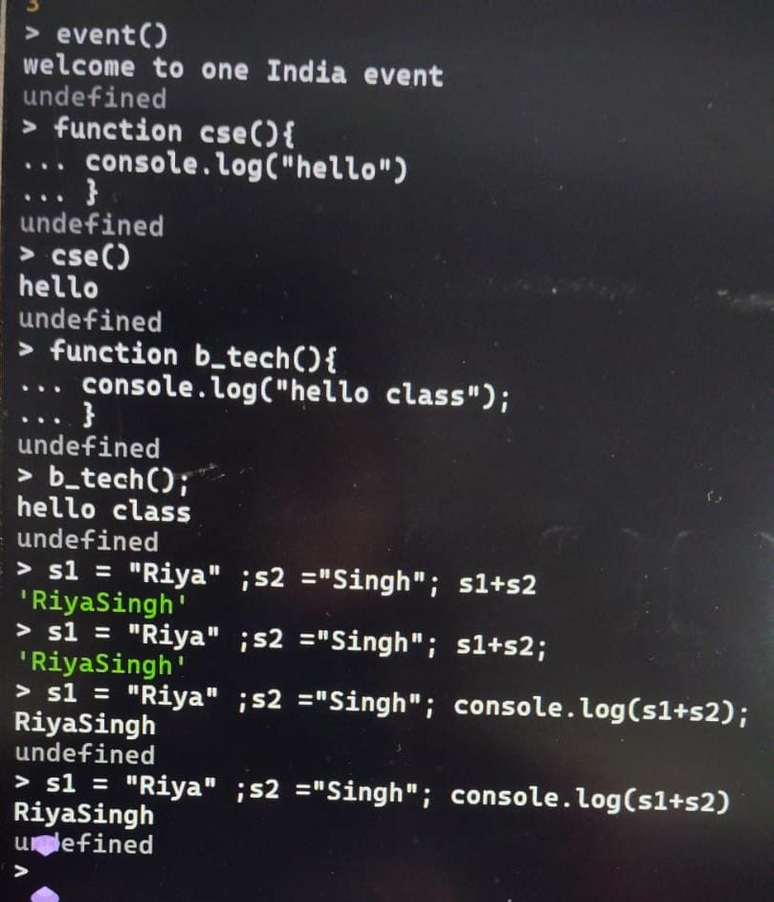

Slide 26
Undefined: definition: “that undefined means something in your code is printing a value that doesn’t exist (undefined) — probably because of a console.log() statement that logs the result of something that doesn’t return anything.

Slide 27
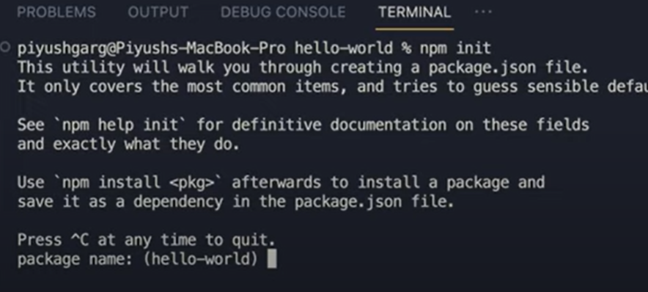
NPM (node package manager)

Slide 28
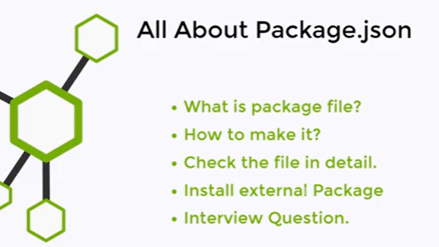
npm init or npm init -y

Slide 29
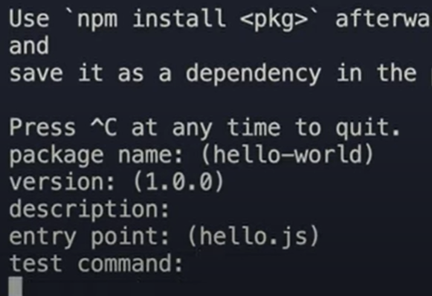

Slide 30
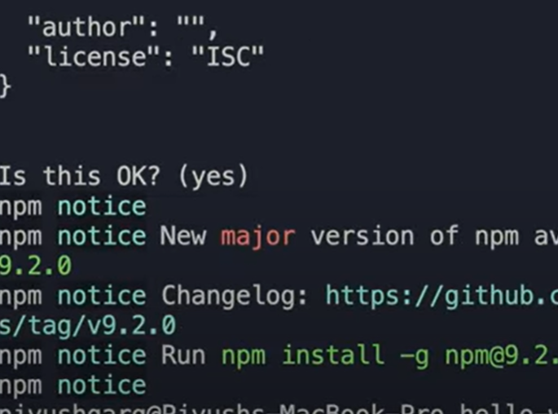

Slide 31
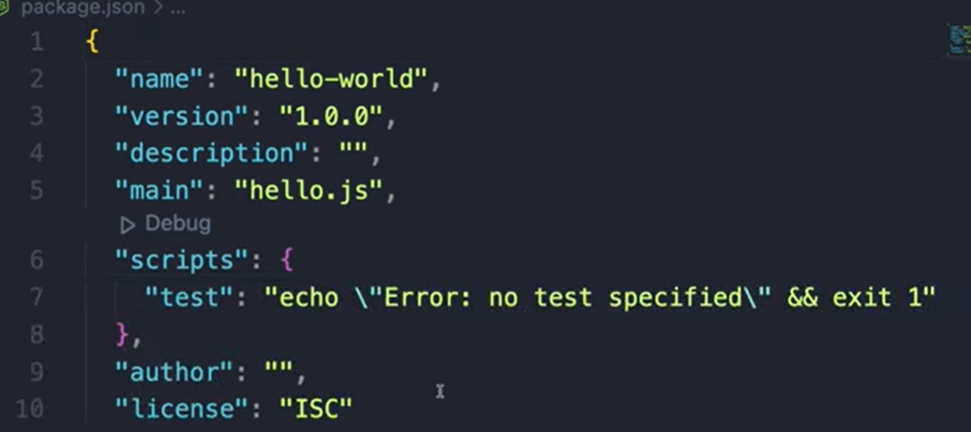

Slide 32
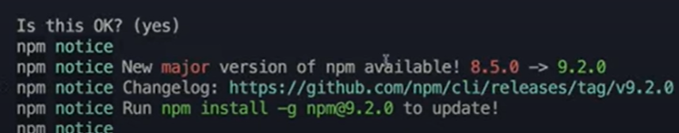

Slide 33
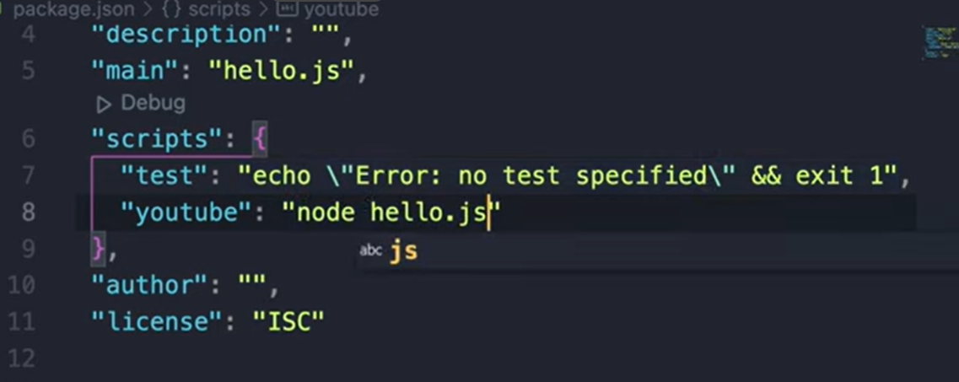

Slide 34
NPM modules (Core Modules, Local Modules, Third Party Modules)
● Node.js uses modules to organize code.
● A module is a file or library with code that can be reused.
● Types of modules in Node.js: 1. Core Modules – Built-in in Node.js
2. Local Modules – Created by the developer
3. Third-Party Modules – Installed via npm

Slide 35
Example (Analogy):
● Core modules = Tools already in your toolbox
● Local modules = Tools you made yourself
● Third-party modules = Tools you bought from the store
Question to students:
● Q: Why do we use modules in Node.js?
● A: To organize code, reuse functionality, and avoid repetition.

Slide 36
Core Modules
● Core modules are pre-installed with Node.js.
● No need to install. Just require them.
Common Core Modules:
● fs – File System
● http – Create servers
● os – Operating System info
● path – Work with file paths
● url – Parse URLs

Slide 37
Example 1: Using fs
const fs = require('fs');
// Create a file
fs.writeFileSync('example.txt', 'Hello World!');
// Read the file
const data = fs.readFileSync('example.txt', 'utf-8');
console.log(data); // Output: Hello World!

Slide 38
Example 2: Using os
const os = require('os');
console.log('OS Platform:', os.platform());
console.log('Free Memory:', os.freemem());

Slide 39
Mini Exercise for Students:
● Q: Use path module to join two folder names folder1 and folder2 into a single path.
● A:
const path = require('path');
console.log(path.join('folder1', 'folder2')); // folder1/folder2
Quick Q&A for Class:
● Q: Do we need to install core modules?
● A: No, they come with Node.js

Slide 40
Local Modules
● Local modules are our own modules created to organize code.
● We use module.exports and require() to share code.

Slide 41
Example 1: Creating a local module
math.js (local module)
// Create a module
function add(a, b) {
return a + b;
}
function multiply(a, b) {
return a * b;
}
// Export functions
module.exports = { add, multiply };
app.js (main file)
const math = require('./math');
console.log(math.add(5, 3)); // 8
console.log(math.multiply(5, 3)); // 15

Slide 42
Mini Exercise:
● Q: Create a local module greet.js with a function sayHello(name) that returns "Hello, name!"
● A:
// greet.js
function sayHello(name) {
return `Hello, ${name}!`;
}
module.exports = sayHello;
// app.js
const greet = require('./greet');
console.log(greet(' NODE JS ')); // Hello, NODE JS!

Slide 43
Quick Q&A for Class:
● Q: How do we export multiple functions from a module?
● A: Using module.exports = { function1, function2 }

Slide 44
Third-Party Modules
● Third-party modules are created by others and installed via npm.
● Example: npm install lodash, npm install express
Steps:
Initialize npm project: npm init -y
2. Install a package:
npm install lodash
3. Use it in code:
const _ = require('lodash');
const numbers = [1, 2, 3, 4];
console.log(_.reverse(numbers)); // [4,3,2,1]

Slide 45
Mini Exercise:
● Q: Install moment module and print the current date in DD-MM-YYYY format
● A:
npm install moment
const moment = require('moment');
console.log(moment().format('DD-MM-YYYY'));
Quick Q&A for Class:
● Q: How do we find and install third-party modules?
● A: Use npm search, then npm install <module-name>

Slide 46
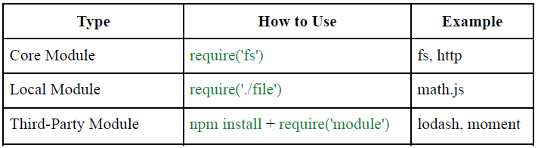
Summary of Module Types

Slide 47
Tips:
● Always check module documentation
● Use meaningful names for local modules
● Keep core modules for essential tasks

Slide 48
Sample Q&A You Can Ask Students
● What is the difference between core, local, and third-party modules?
● How do we export and import functions in a local module?
● How do we install a third-party module using npm?
● Give an example of a core module you have used.

Slide 49
Questions
● Can we install core modules? (No)
● Can a module export multiple functions? (Yes)
● How do we know which third-party module to use? (Check npm docs, popularity, reviews)
● Can we combine core, local, and third-party modules into a single file? (Yes)

Slide 50
Easy Practice Tasks (Revised)
1. Read a file using fs and print its content to the console.
2. Write a file using fs and then read it to confirm the content.
3. Use the os module to display: ○ OS platform
○ Free memory
○ Total memory
4. Use the path module to join three folder names into a single path.
5. Create a local module greet.js with a function sayHello(name) and use it in another file.
6. Create a local module math.js with two functions: add(a,b) and multiply(a,b) and use them.
7. Install lodash (third-party module) and use its reverse() method on an array.
8. Install moment (third-party module) and print the current date in DD-MM-YYYY format.
9. Modify a local module to export multiple functions, e.g., add, subtract, multiply, divide, and use them in another file.
10. Combine core + local + third-party modules in one file: ○ Use fs to read a file
○ Use your local module to process data
○ Use lodash to manipulate an array

Slide 51
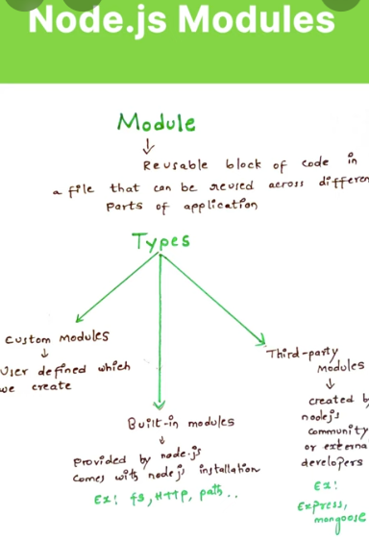
NODE JS MODULES

Slide 52
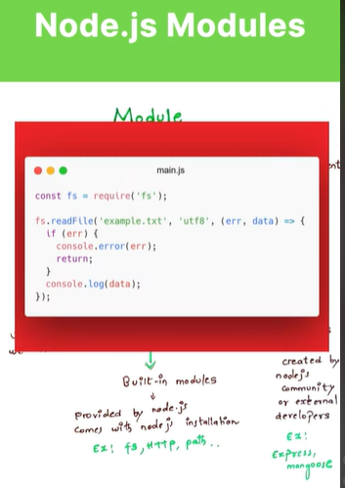
CORE MODULE

Slide 53
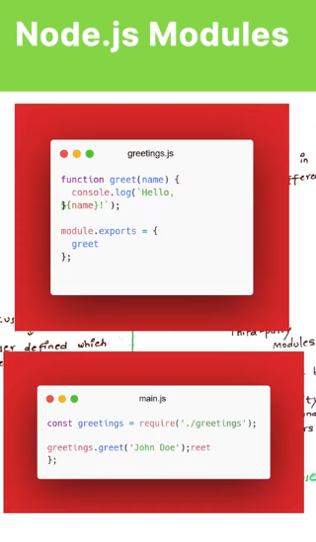
LOCAL MODULE

Slide 54
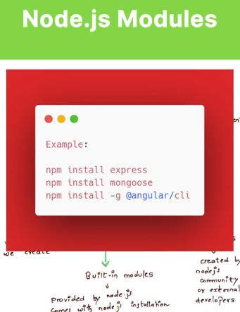
THIRD PARTY MODULE

Slide 55
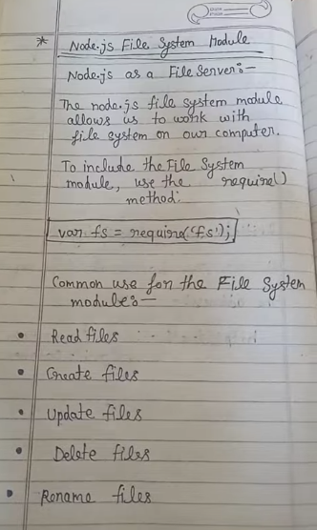
FS MODULE

Slide 56
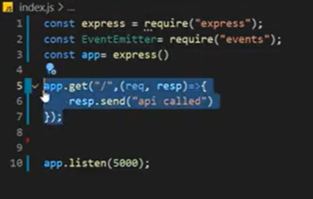
Event Emitter

Slide 57
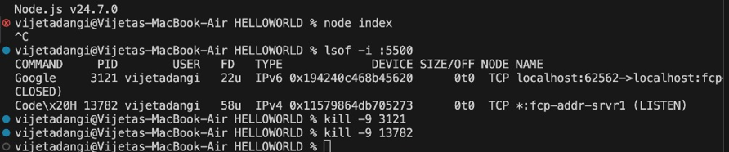
If Access Denied Problem during execution the solution is :

Slide 58
//event emitter
const express = require("express");
const EventEmitter=require(“event”);
const app = express();
app.get("/", (req, resp) => {
resp.send("home");
});
app.get("/home", (req, resp) => {
resp.send("<h1 style=color:blue>about called</h1>");
});
app.listen(5000);

Slide 59
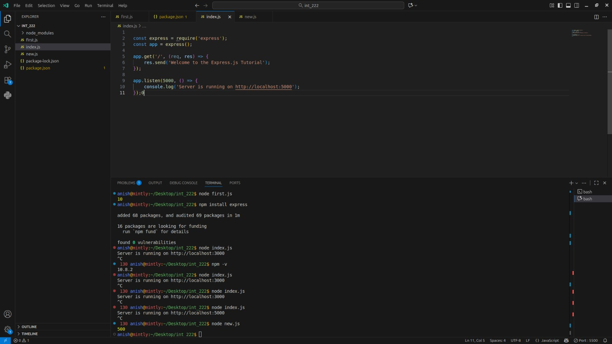
Event Emitter

Slide 60
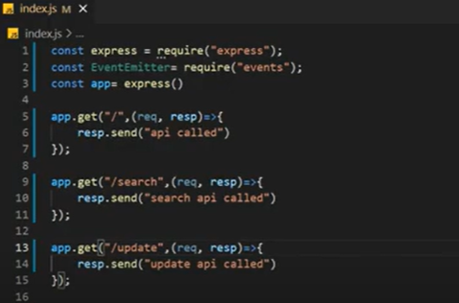
Event Emitter

Slide 61
EventEmitter in Node.js
How to install express?
Ans. npm install express
OR
npm init –y
node index.js

Slide 62
//auto exe. Of code or program
npm i nodemon –g or
npm i nodemon –g0
nodemon run
File → Auto Save

Slide 63
If Someone having error during Installation
Open PowerCell →Run as Admin.
Set-ExecutionPolicy RemoteSigned then press enter
Type Y then Enter
Then close and open again VS Code

Slide 64
npm install colors
var colors = require('colors');
console.log('hello'.green); // outputs green text
console.log('i like cake and pies'.underline.red) // outputs red underlined text
console.log('inverse the color'.inverse); // inverses the color
console.log('OMG Rainbows!'.rainbow); // rainbow
console.log('Run the trap'.trap); // Drops the bass

Slide 65
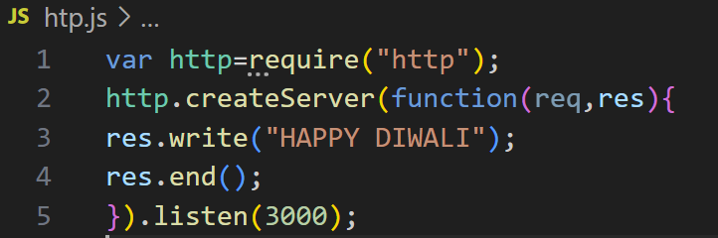
“http Server” in node js OR Setting up a basic HTTP server

Slide 66
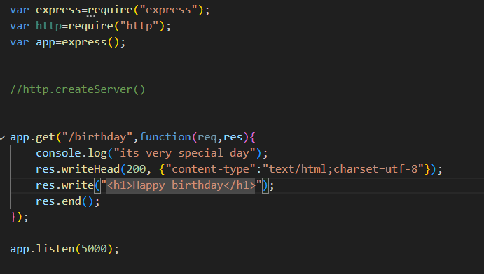
Understanding Request and Response objects

Slide 67
Object | Full Name | Purpose | Common Properties / Methods
req | Request Object | Represents the incoming request from the client (browser, API, etc.) | req.url, req.method, req.headers, req.on('data')
res | Response Object | Represents the outgoing response sent from the server back to the client | res.writeHead(), res.write(), res.end()

Slide 68
Implementing basic routing
Routing means deciding how the server responds to a specific URL (path) and HTTP method (GET, POST, etc.). It helps you define different pages or API endpoints in your server.

Slide 69
const http = require('http');
const server = http.createServer((req, res) => {
res.writeHead(200, { 'Content-Type': 'text/html' });
if (req.url === '/' && req.method === 'GET') {
res.write('<h1>Home Page</h1>');
}
else if (req.url === '/about' && req.method === 'GET') {
res.write('<h1>About Page</h1>');
}
else if (req.url === '/contact' && req.method === 'GET') {
res.write('<h1>Contact Page</h1>');
}
else {
res.writeHead(404, { 'Content-Type': 'text/html' });
res.write('<h1>404 Page Not Found</h1>');
}
res.end();
});
const PORT = 3000;
server.listen(PORT, () => {
console.log(`Server running at http://localhost:${PORT}`);
});
Implementing basic routing via
(Header and Status in Server)
GET METHOD

Slide 70
POST METHOD
const express = require('express');
const app = express();
const port = 3000;
// Middleware to parse JSON data from POST requests
app.use(express.json());
// POST route example
app.post('/submit', (req, res) => {
const { name, age } = req.body;
res.send(`Hello ${name}, you are ${age} years old!`);
});
// Start the server
app.listen(port, () => {
console.log(`Server running at http://localhost:${port}`);
});

Slide 71
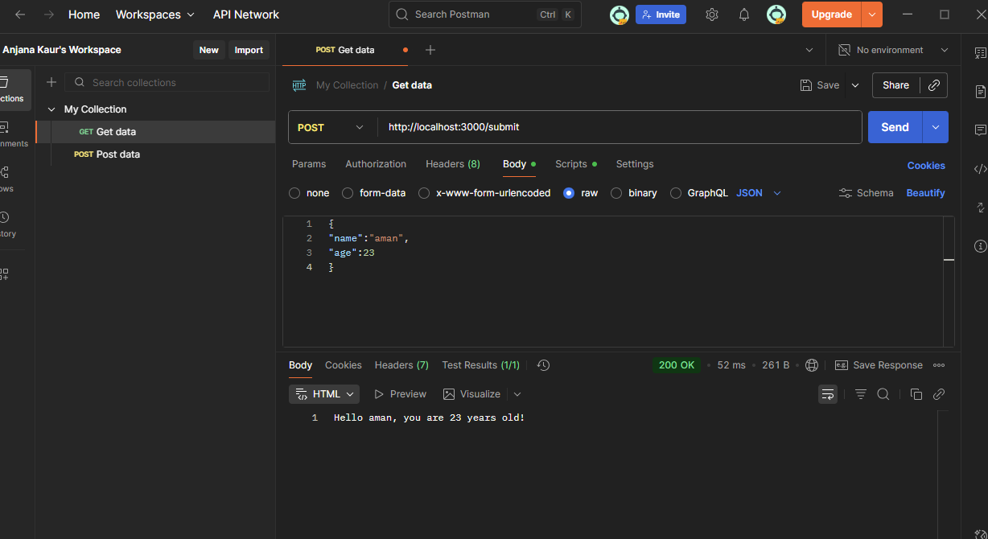

Slide 72
//ON MAC SYSTEM(POSTMAN ALSO WORK HERE TO POST SUBMIT PAGE)
+
PRESS WINDOW KEY THEN TYPE CMD AND THESE 2 LINES TOO
curl -X POST http://localhost:3000/submit \ -H "Content-Type: application/json" \ -d '{"name": "Akshat", "age": 21}'

Slide 73
const express = require('express’);
const path = require('path’);
const app = express();
// Middleware to parse form data and JSON
app.use(express.urlencoded({ extended: true }));
app.use(express.json());
// Serve the HTML form
app.get('/', (req, res) => { res.sendFile(path.join(__dirname, 'index.html'));});
// POST route to handle submitted
dataapp.post('/submit', (req, res) => { const { name, age } = req.body;
res.send(hellp ${name}, you are ${age} years old);});
// Start the server
app.listen(4000, () => { console.log('Server running on http://localhost:4000');});

Slide 74
<!DOCTYPE html>
<html lang="en">
<head> <meta charset="UTF-8" /> <meta name="viewport" content="width=device-width, initial-scale=1.0" /> <title>Submit Form</title>
<style>
body {
font-family: Arial, sans-serif;
background-color: #f8f9fa; display: flex;
height: 100vh; justify-content: center; align-items: center; } form { background: white; padding: 20px 30px; border-radius: 10px; box-shadow: 0 2px 10px rgba(0,0,0,0.1);
} input { display: block; margin: 10px 0; padding: 8px; width: 250px; } button { background-color: #007bff; color: white; border: none; padding: 8px 15px; border-radius: 5px; cursor: pointer; } button:hover { background-color: #0056b3; } </style> </head>
<body> <form action="/submit" method="POST"> <h2>Enter Your Details</h2> <input type="text" name="name" placeholder="Enter your name" required /> <input type="number" name="age" placeholder="Enter your age" required /> <button type="submit">Submit</button> </form> </body></html>

Slide 75
POST METHOD
& BODY PARSER
// Import Express
const express = require('express');
const app = express();
app.use(express.json()); // To parse JSON body
// GET request
app.get('/user', (req, res) => {
res.send(`Received GET request with name: ${req.query.name}`);
});
// POST request
app.post('/user', (req, res) => {
res.send(`Received POST request with name: ${req.body.name}`); //BODY PARSER
});
app.listen(3000, () => console.log('Server running on port 3000'));

Slide 76
Feature | GET Method | POST Method
Purpose | Used to retrieve data from the server. | Used to send data to the server (e.g., to create or update).
Data Transmission | Data is sent in the URL as query parameters. | Data is sent in the body of the request.
Visibility | Data is visible in the URL, not secure for sensitive data. | Data is hidden from the URL, more secure.
Data Length Limit | Limited by the maximum URL length. | Can send large amounts of data (no URL limit).
Caching | Requests are cached by default. | Requests are not cached by default.
Use Case | Commonly used for fetching or reading data. | Commonly used for creating or updating data.
Browser History | GET requests are stored in browser history. | POST requests are not stored in browser history.
Bookmarking | Can be bookmarked (since parameters are in the URL). | Cannot be bookmarked easily.
Example in Node.js (Express) | js<br>app.get('/user', (req, res) => {<br> res.send('GET request received');<br>}); | js<br>app.post('/user', (req, res) => {<br> res.send('POST request received');<br>});
Accessing Data | req.query (for query parameters). | req.body (requires middleware like express.json()).

Slide 77
Concept | Meaning
req.url | URL requested by the client
req.method | HTTP method (GET, POST, etc.)
res.writeHead() | Sets response status & headers
res.write() | Writes content to send back
res.end() | Ends the response

Slide 78
Setting response headers and status codes
// Import the http module
const http = require('http');
// Create the server
const server = http.createServer((req, res) => {
// Set the HTTP status and headers
res.statusCode = 200;
res.setHeader('Content-Type', 'text/plain');
// Send a response body
res.end('Hello, World!\n');
});
// Start listening on port 3000
server.listen(3000, () => {
console.log('Server running at http://localhost:3000/');
});

Slide 79
Callbacks in Node.js
Type clear OR cls in terminal rather than close this window.

Slide 80
Common HTTP Status Code
Code | Meaning
200 | OK
201 | Created
400 | Bad Request
401 | Unauthorized
403 | Forbidden
404 | Not Found
500 | Internal Server Error

Slide 81
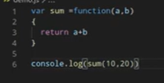
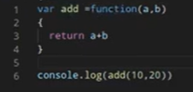
CALL BACK FUNCTIONS

Slide 82
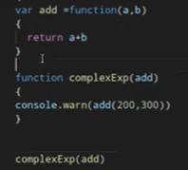
CALL BACK FUNCTIONS

Slide 83
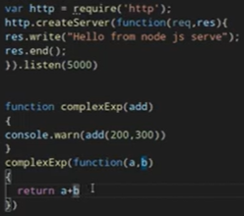
HTTP MODULE & CREATE HTTP SERVER

Slide 84
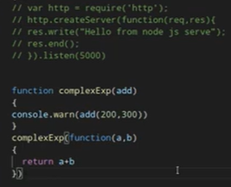
Module & CALL BACK FUNCTION

Slide 85
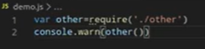
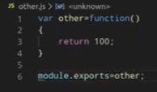
demo.js
LOCAL MODULE (MIN. 2 FILES)
other.js

Slide 86

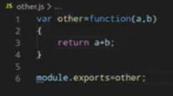
LOCAL MODULE (MIN. 2 FILES)

Slide 87
Node.js often uses callbacks — functions passed into other functions. Anonymous functions are perfect for that.
const add = function(a, b) {
return a + b;
};
console.log(add(2, 3)); // 5
Arrow Function (Modern Anonymous Function)
Arrow functions are the modern way to write anonymous functions. They are shorter and automatically bind this to the surrounding scope.
const add = (a, b) => a + b;
console.log(add(2, 3)); // 5

Slide 88
Type | Description | Source / Location | How to Import | Examples
🧩 Core Module | Built into Node.js — available without installing anything. | Comes with Node.js itself. | require('module_name') | fs, http, path, os, events, crypto
📁 Local Module | Custom modules that you create within your project. | Stored in your project files (e.g., ./utils.js). | require('./filename') | require('./math'), require('../config/settings')
📦 Third-Party Module | Created by others and installed via npm (Node Package Manager). | Installed in node_modules folder. | require('package_name') | require('express'), require('lodash'), require('mongoose')

Slide 89
Core module
const fs = require('fs'); // File System module
fs.writeFileSync('hello.txt', 'Hello from Node.js!');
console.log('File created successfully!');

Slide 90
Local module
//math.js
exports.add = (a, b) => a + b;
exports.sub = (a, b) => a - b;
//app.js
const math = require('./math');
console.log(math.add(5, 3)); // 8

Slide 91
Third Party module
npm install chalk
//demo.js
const chalk = require('chalk');
console.log(chalk.green('Success!'));
console.log(chalk.red('Error!'));

Slide 92
Stream Module
In Node.js, the Stream module is used to handle streaming data — data that’s read or written piece by piece instead of all at once. This is useful for handling large files, network requests, or real-time data efficiently.
Types of StreamsNode.js provides four main types of streams:Readable – to read data (e.g., fs.createReadStream)Writable – to write data (e.g., fs.createWriteStream)Duplex – both readable and writable (e.g., net.Socket)Transform – Duplex stream that can modify or transform data (e.g., zlib.createGzip)

Slide 93
const { pipeline } = require('node:stream/promises');
const fs = require('node:fs');
const zlib = require('node:zlib');
async function run() {
await pipeline(
fs.createReadStream('archive.tar'),
zlib.createGzip(),
fs.createWriteStream('archive.tar.gz'),
);
console.log('Pipeline succeeded.');
}
run().catch(console.error);

Slide 94
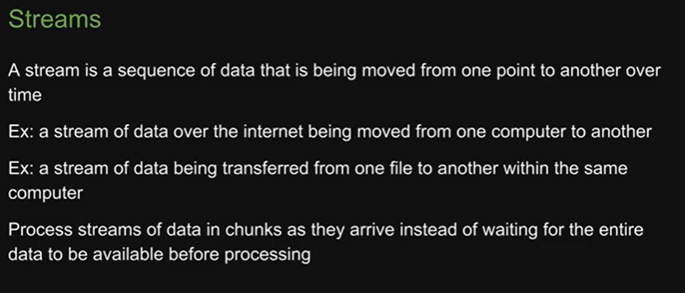

Slide 95
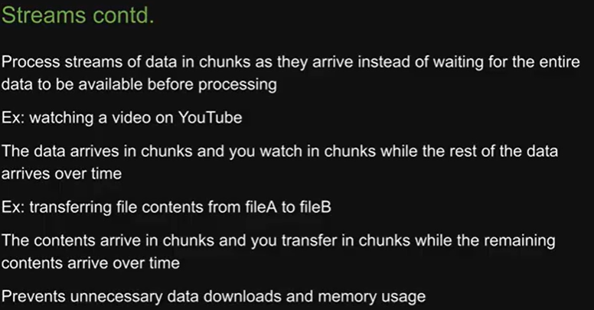

Slide 96



Slide 97
Example
// streamExample.js
const fs = require('fs');
// Create a readable stream
const readableStream = fs.createReadStream('input.txt', 'utf8');
// Create a writable stream
const writableStream = fs.createWriteStream('output.txt');
// Use the pipe() method to automatically read and write data chunks
readableStream.pipe(writableStream);
console.log('File is being copied using streams...');

Slide 98
How it Works
fs.createReadStream() reads the file in chunks.
fs.createWriteStream() writes those chunks to another file.
.pipe() connects them so data flows automatically from source → destination.
This avoids loading the whole file into memory, which is great for large files.

Slide 99
Example with Manual Data Events
If you want more control, you can handle the data, end, and error events manually:
const fs = require('fs');
const readable = fs.createReadStream('input.txt', 'utf8');
const writable = fs.createWriteStream('output.txt');
readable.on('data', (chunk) => {
console.log('New chunk received:', chunk);
writable.write(chunk);
});
readable.on('end', () => {
console.log('File streaming completed.');
});
readable.on('error', (err) => {
console.error('Error:', err);
});

Slide 100
const fs = require('fs');
const { Transform } = require('stream');
const upperCaseTransform = new Transform({
transform(chunk, encoding, callback) {
// Convert chunk to uppercase
this.push(chunk.toString().toUpperCase());
callback();
}
});
fs.createReadStream('input.txt', 'utf8')
.pipe(upperCaseTransform)
.pipe(fs.createWriteStream('output.txt'));
console.log('File transformed to uppercase using streams.');
Example of a Transform Stream (Optional)
You can also modify data on the fly using a Transform stream:

Slide 101
Task | Method
Read file | fs.createReadStream()
Write file | fs.createWriteStream()
Connect streams | .pipe()
Transform data | Transform stream

Slide 102
Compression and Decompression via Zlib
What is zlib?
zlib is a built-in Node.js module that provides compression and decompression functionality using popular algorithms like Gzip, Deflate, and others.
You can use it for:
Compressing strings, buffers, or files.
Decompressing data sent from servers or read from compressed files.

Slide 103


Slide 104


Slide 105
1. Import the zlib and fs modules
const zlib = require('zlib');
const fs = require('fs');

Slide 106
2. Compressing Data
Example: Compress a string
const input = 'This is some data that we want to compress';
// Convert string to buffer
const buffer = Buffer.from(input, 'utf-8');
// Compress using gzip
zlib.gzip(buffer, (err, compressedBuffer) => {
if (err) {
console.error('Compression error:', err);
return;
}
console.log('Compressed data:', compressedBuffer);
// Save to file (optional)
fs.writeFileSync('data.gz', compressedBuffer);
});

Slide 107
3. Decompressing Data
Example: Decompress from a .gz file
const compressedData = fs.readFileSync('data.gz');
zlib.gunzip(compressedData, (err, decompressedBuffer) => {
if (err) {
console.error('Decompression error:', err);
return;
}
console.log('Decompressed data:', decompressedBuffer.toString());
});

Slide 108
4. Using Streams (for large files)
If you’re working with large files, use streams to avoid loading everything into memory.
//Compress a file
const gzip = zlib.createGzip();
const input = fs.createReadStream('input.txt');
const output = fs.createWriteStream('input.txt.gz');
input.pipe(gzip).pipe(output);
//Decompress a file
const gunzip = zlib.createGunzip();
const input = fs.createReadStream('input.txt.gz');
const output = fs.createWriteStream('input_decompressed.txt');
input.pipe(gunzip).pipe(output);

Slide 109
Method | Compress | Decompress | Description
Gzip | zlib.gzip() | zlib.gunzip() | Common for web data
Deflate | zlib.deflate() | zlib.inflate() | Compact compression
Brotli | zlib.brotliCompress() | zlib.brotliDecompress() | Newer, efficient method

Slide 110
Example: Using Brotli
zlib.brotliCompress(Buffer.from('Hello Brotli!'), (err, compressed) => {
if (err) throw err;
zlib.brotliDecompress(compressed, (err, decompressed) => {
if (err) throw err;
console.log(decompressed.toString()); // "Hello Brotli!"
});
});

Slide 111
Task | Function
Compress string/buffer | zlib.gzip() / zlib.deflate() / zlib.brotliCompress()
Decompress string/buffer | zlib.gunzip() / zlib.inflate() / zlib.brotliDecompress()
Compress file (stream) | createGzip() / createDeflate()
Decompress file (stream) | createGunzip() / createInflate()

Slide 112

//run code automatically
nodemon ./index.js

Slide 113

Promises and async/await

Slide 114

Asynchronous, Await and Promise

Slide 115
Concept | Purpose | Key Point | Example
Promise | Handles async operations | Has states: pending, fulfilled, rejected | new Promise((res, rej) => res("Done"))
async | Declares a function returning a Promise | Allows use of await inside | async function f(){ return "Hi"; }
await | Waits for a Promise to resolve | Used only inside async functions | let x = await fetchData();

Slide 116
Concept | Description | Syntax Example | Key Features | Common Use Case
Promise | Represents the eventual completion (or failure) of an asynchronous operation and its resulting value. | js\nlet promise = new Promise((resolve, reject) => {\n setTimeout(() => resolve("Done!"), 1000);\n});\n\npromise.then(result => console.log(result)); | - Has 3 states: pending, fulfilled, rejected.- Used to avoid callback hell.- Can chain .then() and .catch(). | When performing asynchronous operations like API calls, file I/O, or DB queries.
async | Declares a function that always returns a Promise. Inside it, you can use await. | js\nasync function greet() {\n return "Hello";\n}\n\ngreet().then(console.log); | - Simplifies working with Promises.- Automatically wraps return values in a Promise. | Used to mark a function that will handle asynchronous logic using await.
await | Pauses the execution of an async function until a Promise is resolved or rejected. | js\nasync function run() {\n let result = await new Promise(res => setTimeout(() => res("Done!"), 1000));\n console.log(result);\n}\n\nrun(); | - Works only inside an async function.- Makes async code look synchronous.- Prevents callback chaining. | Used to wait for asynchronous operations like reading files, fetching data, or DB queries.

Slide 117


Slide 118
Middleware in Node JS
In Node.js, especially when using Express.js, middleware refers to functions that have access to the request (req), response (res), and the next middleware function in the application’s request–response cycle.
Middleware functions are used to modify requests and responses, perform logging, handle errors, perform authentication, and more.
They are executed in the order they are defined.

Slide 119
Middleware Syntax:
app.use((req, res, next) => {
console.log('Middleware executed');
next(); // Pass control to the next middleware
});

Slide 120
Middleware Parameters
req → The request object
res → The response object
next → Function that passes control to the next middleware
err → (Optional) Used for error-handling middleware

Slide 121
body parser in Node.js
A body parser in Node.js is a middleware that parses the incoming request body before your request handlers process it — for example, reading form data or JSON sent from a client.
In modern Express.js (v4.16.0 and above), you don’t need to install body-parser separately, because Express now includes it built-in.

Slide 122
// Import express
const express = require('express');
const app = express();
// Parse JSON data
app.use(express.json());
// Parse URL-encoded data (e.g., form submissions)
app.use(express.urlencoded({ extended: true }));
// Example POST route
app.post('/user', (req, res) => {
console.log(req.body); // Access parsed data
res.send(`Hello ${req.body.name}!`);
});
// Start server
app.listen(3000, () => {
console.log('Server running on http://localhost:3000');
});
npm install body-parser
What is body-parser in Node.js? 🤔 Quick & Easy Guide🚀 #short#shorts #viral#nodejs #backend #npm - YouTube

Slide 123


Middleware

Slide 124
const express=require("express");
const app= express();
const reqFilter=(req,res,next)=>{
//console.log(reqFilter);
if(!req.query.age){
res.send("Please provide correct age")
}
else if(req.query.age<18){
res.send("You cann't access this page")
}
else{
next();
}
}
app.use(reqFilter);
app.get("/home", (req,res)=>{
res.send("Welcome to home page")
})
app.get("/users", (req,res)=>{
res.send("Welcome to user page")
})
app.get("/about", (req,res)=>{
res.send("Welcome to about page")
})
app.get("/contact", (req,res)=>{
res.send("Welcome to contact page")
})
app.listen(5000)

Slide 125
localhost:5000/users?age=13
localhost:5000/users?age=23

Slide 126


Slide 127


Slide 128


Slide 129

middleware.js

Slide 130


Slide 131


Slide 132


Slide 133


Slide 134


Slide 135


Slide 136
Why Use express.Router?
✅ Cleaner code organization ✅ Easier maintenance for large applications ✅ Logical grouping of routes ✅ Reusable route modules
project-folder/
│
├── app.js
└── routes/
└── userRoutes.js

Slide 137
const express = require('express');
const app = express();
// Import router
const userRouter = require('./routes/userRoutes');
// Middleware to parse JSON
app.use(express.json());
// Mount the router
app.use('/users', userRouter);
app.get('/', (req, res) => {
res.send('Welcome to the Home Page');
});
app.listen(3000, () => {
console.log('Server running on port 3000');
});
main.js

Slide 138
const express = require('express');
const router = express.Router();
// Example routes
router.get('/', (req, res) => {
res.send('List of all users');
});
router.get('/:id', (req, res) => {
res.send(`User details for ID: ${req.params.id}`);
});
router.post('/', (req, res) => {
const newUser = req.body;
res.send(`User created: ${JSON.stringify(newUser)}`);
});
module.exports = router;
routes/userRoutes.js
If you start your server and visit:
http://localhost:3000/ → “Welcome to the Home Page”
http://localhost:3000/users → “List of all users”
http://localhost:3000/users/5 → “User details for ID: 5”

Slide 139
Express Validator is a set of Express.js middlewares that wraps the validator.js library. It helps you validate and sanitize incoming request data (e.g., from req.body, req.params, or req.query).
npm install express express-validator
project/
│
├── app.js
└── package.json

Slide 140
body('age')
.optional()
.isInt({ min: 18 }).withMessage('You must be at least 18 years old'),
],
(req, res) => {
// Finds validation errors in this request
const errors = validationResult(req);
if (!errors.isEmpty()) {
// If there are validation errors, return them
return res.status(400).json({ errors: errors.array() });
}
// If validation passed
res.json({
message: 'User registered successfully!',
data: req.body,
});
}
);
// Start the server
app.listen(3000, () => console.log('Server running on port 3000'));
const express = require('express');
const { body, validationResult } = require('express-validator');
const app = express();
app.use(express.json()); // To parse JSON request body
// POST /register route
app.post(
'/register',
[
// Validation rules
body('name')
.notEmpty().withMessage('Name is required')
.isLength({ min: 3 }).withMessage('Name must be at least 3 characters long'),
body('email')
.isEmail().withMessage('Please enter a valid email’),
body('password')
.isLength({ min: 6 }).withMessage('Password must be at least 6 characters long'),

Slide 141
curl -X POST http://localhost:3000/register \
-H "Content-Type: application/json" \
-d '{"name": "John Doe", "email": "john@example.com", "password": "secret123", "age": 22}'
//JSON FILE ON POSTMAN
{
"message": "User registered successfully!",
"data": {
"name": "John Doe",
"email": "john@example.com",
"password": "secret123",
"age": 22
}
}

Slide 142
//RESPONSE
{
"errors": [
{ "msg": "Name is required", "param": "name", "location": "body" },
{ "msg": "Please enter a valid email", "param": "email", "location": "body" },
{ "msg": "Password must be at least 6 characters long", "param": "password", "location": "body" }
]
}
//SANITIZATION
//This cleans up whitespace or unwanted characters before validation.
body('email').normalizeEmail(),
body('name').trim().escape(),

Slide 143
Task | Method
Import validator | const { body, validationResult } = require('express-validator')
Add validation | Pass array of body() middlewares before route handler
Check results | validationResult(req)
Return errors | res.status(400).json({ errors: errors.array() })

Slide 144
express-session is a middleware for Express that allows you to store data about a user between HTTP requests — for example:
login sessions
shopping carts
temporary flash messages
npm install express express-session

Slide 145
// Route to get session variable
app.get('/get-session', (req, res) => {
if (req.session.username) {
res.send(`Hello ${req.session.username}`);
} else {
res.send('No session found');
}
});
// Route to destroy the session
app.get('/logout', (req, res) => {
req.session.destroy(err => {
if (err) {
return res.send('Error destroying session');
}
res.send('Session destroyed!');
});
});
app.listen(PORT, () => {
console.log(`Server running on http://localhost:${PORT}`);
});
const express = require('express');
const session = require('express-session');
const app = express();
const PORT = 3000;
// Configure session middleware
app.use(session({
secret: 'mysecretkey', // change this to a strong secret key
resave: false, // don’t save session if unmodified
saveUninitialized: true, // save new sessions
cookie: { secure: false } // set true if using https
}));
// Route to set a session variable
app.get('/set-session', (req, res) => {
req.session.username = 'JohnDoe';
res.send('Session data set!');
});

Slide 146
node app.js
Then open your browser:
Go to http://localhost:3000/set-session → sets the session.
Go to http://localhost:3000/get-session → retrieves the session data.
Go to http://localhost:3000/logout → destroys the session.

Slide 147
cookie-parser
What it does
It’s a middleware that parses cookies attached to the client request.
It makes cookies available under req.cookies.
npm install cookie-parser

Slide 148
// app.js
const express = require('express');
const cookieParser = require('cookie-parser');
const app = express();
// Use cookie-parser middleware
app.use(cookieParser('mysecret')); // optional secret for signed cookies
app.get('/', (req, res) => {
// Set a cookie
res.cookie('username', 'JohnDoe', { maxAge: 60000 }); // expires in 1 min
res.send('Cookie has been set!');
});
app.get('/read-cookie', (req, res) => {
// Access cookies
console.log(req.cookies);
res.send(`Hello ${req.cookies.username}`);
});
app.get('/clear-cookie', (req, res) => {
res.clearCookie('username');
res.send('Cookie cleared!');
});
app.listen(3000, () => console.log('Server running on http://localhost:3000'));

Slide 149
Output
Visit / → sets a cookie.
Visit /read-cookie → reads username cookie.
Visit /clear-cookie → removes it.

Slide 150
cookie-session
🔹 What it does
It stores session data inside a cookie (instead of in-memory or database).
Unlike express-session, there’s no session store — data is client-side.
Good for small session data (not for large or sensitive data).
npm install cookie-session

Slide 151
app.get('/', (req, res) => {
// Initialize counter
req.session.views = (req.session.views || 0) + 1;
res.send(`You have visited this page ${req.session.views} times.`);
});
app.get('/logout', (req, res) => {
req.session = null; // clear session
res.send('Session cleared!');
});
app.listen(3000, () => console.log('Server running on http://localhost:3000'));
// app.js
const express = require('express');
const cookieSession = require('cookie-session');
const app = express();
// Use cookie-session middleware
app.use(
cookieSession({
name: 'session',
keys: ['secret1', 'secret2'], // used to sign the cookies
maxAge: 24 * 60 * 60 * 1000, // 24 hours
})
);

Slide 152
Output
Each refresh of / → increments visit counter (stored in cookie).
Visit /logout → clears session.

Slide 153
Feature | cookie-parser | cookie-session
Purpose | Parses cookies | Manages session data in cookies
Data storage | Cookies (read/write manually) | Session cookie (auto-managed)
Signed cookies | Yes (optional secret) | Yes (always signed)
Use case | Simple cookie handling | Lightweight session management

Slide 154
What is app.all()?
🔹 Definition:
app.all(path, callback) is used to handle all HTTP methods (GET, POST, PUT, DELETE, etc.) for a specific route or path.

Slide 155
app.get('/test', ...)
app.post('/test', ...)
app.put('/test', ...)
app.all('/test', ...)

Slide 156
const express = require('express');
const app = express();
app.use(express.json());
// Middleware for all methods on /user route
app.all('/user', (req, res, next) => {
console.log('Accessing the /user route');
next(); // pass control to next handler
});
app.get('/user', (req, res) => {
res.send('GET request to /user');
});
app.post('/user', (req, res) => {
res.send('POST request to /user');
});
app.listen(3000, () => console.log('Server running on http://localhost:3000'));

Slide 157
Accessing the /user route
This message appears for every request (GET, POST, etc.) made to /user.

Slide 158
Method | Description
app.get() | Handles only GET requests
app.post() | Handles only POST requests
app.all() | Handles all request methods for a given route
Typical Use | Logging, authentication, or middleware for a route

Slide 159

Request Type | Example Command | Response
GET | curl http://localhost:3000/api | Received a GET request on /api
POST | curl -X POST http://localhost:3000/api | Received a POST request on /api
PUT | curl -X PUT http://localhost:3000/api | Received a PUT request on /api
DELETE | curl -X DELETE http://localhost:3000/api | Received a DELETE request on /api

Slide 160
Understanding Network Sockets
A network socket is an endpoint for communication between two machines over a network. It allows programs to send and receive data, typically using TCP or UDP protocols.
Socket Type | Protocol | Characteristics
Stream Socket | TCP | Reliable, connection-oriented
Datagram Socket | UDP | Faster, connectionless, no delivery guarantee

Slide 161
When you open a webpage, your browser creates a TCP socket to connect to a web server (HTTP). For real-time applications (like chat), we often use WebSockets.
Creating a Basic WebSocket Server
WebSocket is a protocol that allows two-way, real-time communication between the client and server over a single, long-lived connection.

Slide 162
mkdir websocket-server
cd websocket-server
npm init -y
npm install ws

Slide 163
const WebSocket = require('ws');
// Create WebSocket server on port 8080
const wss = new WebSocket.Server({ port: 8080 });
wss.on('connection', (socket) => {
console.log('New client connected');
// Send a welcome message
socket.send('Welcome to WebSocket Server!');
// Listen for messages from client
socket.on('message', (message) => {
console.log(`Received: ${message}`);
socket.send(`Server received: ${message}`);
});
// Handle disconnect
socket.on('close', () => {
console.log('Client disconnected');
});
});
console.log('WebSocket server running on ws://localhost:8080');

Slide 164
const ws = new WebSocket('ws://localhost:8080');
ws.onmessage = (msg) => console.log(msg.data);
ws.send('Hello Server!');
Sending and Receiving Messages
In WebSockets:
The server and client can both send messages any time.
Messages are sent as text or binary data.

Slide 165
// Server sending broadcast message to all connected clients
wss.clients.forEach((client) => {
if (client.readyState === WebSocket.OPEN) {
client.send('This is a broadcast message!');
}
});
A Socket.IO Chat Server in Node.js (with Example)
Socket.IO simplifies real-time communication — it builds on WebSockets and adds:
Automatic reconnection
Event-based messaging
Room and namespace support

Slide 166
mkdir socketio-chat
cd socketio-chat
npm init -y
npm install express socket.io

Slide 167
// Listen for chat messages
socket.on('chat message', (msg) => {
console.log('Message: ' + msg);
// Broadcast message to all clients
io.emit('chat message', msg);
});
// Handle disconnect
socket.on('disconnect', () => {
console.log('User disconnected');
});
});
server.listen(3000, () => {
console.log('Server running on http://localhost:3000');
});
const express = require('express');
const http = require('http');
const { Server } = require('socket.io');
const app = express();
const server = http.createServer(app);
const io = new Server(server);
app.get('/', (req, res) => {
res.sendFile(__dirname + '/index.html');
});
// When a client connects
io.on('connection', (socket) => {
console.log('A user connected');

Slide 168
const socket = io();
const form = document.getElementById('form');
const input = document.getElementById('input');
const messages = document.getElementById('messages');
form.addEventListener('submit', (e) => {
e.preventDefault();
if (input.value) {
socket.emit('chat message', input.value);
input.value = '';
}
});
socket.on('chat message', (msg) => {
const li = document.createElement('li');
li.textContent = msg;
messages.appendChild(li);
});
</script>
</body>
</html>
<!DOCTYPE html>
<html>
<head>
<title>Socket.IO Chat</title>
<style>
ul { list-style-type: none; margin: 0; padding: 0; }
li { padding: 8px; }
input { padding: 10px; width: 80%; }
button { padding: 10px; }
</style>
</head>
<body>
<ul id="messages"></ul>
<form id="form">
<input id="input" autocomplete="off" /><button>Send</button>
</form>
<script src="/socket.io/socket.io.js"></script>
<script>

Slide 169
node server.js
Then open http://localhost:3000 in multiple browsers — try chatting between them!

Slide 170
Concept | Description
Network Socket | Endpoint for network communication
WebSocket | Persistent two-way connection (TCP-based)
Socket.IO | Higher-level library built on WebSockets with auto-reconnect, events, and rooms
Use Case | Real-time apps like chat, notifications, games, dashboards

Slide 171
Notes
secret is used to sign the session ID cookie — make sure it’s unique and not shared publicly.
By default, sessions are stored in memory, which is not suitable for production. For production, use a session store such as:
connect-mongo (MongoDB)
connect-redis (Redis)
session-file-store
npm install connect-mongo

Slide 172
const MongoStore = require('connect-mongo');
app.use(session({
secret: 'mysecretkey',
store: MongoStore.create({ mongoUrl: 'mongodb://localhost/sessiondb' }),
resave: false,
saveUninitialized: false
}));

Slide 173
REFERENCES
https://youtu.be/2e2E5cvLw0g?si=0fYKqyRuXti8mS3G
(PlayList => Node JS by Anil Sidhu)
https://www.youtube.com/watch?v=ohIAiuHMKMI&list=PLinedj3B30sDby4Al-i13hQJGQoRQDfPo
(PlayList => Node JS by Piyush Garg)
(465) Backend with Node.js – YouTube
(PlayList => Node JS by Dr. Naveet Kaur)

Slide 174
THANK YOU

